Slide 1
Data in the real world
How do we use data to create infographics, and how do we use these to compare data.

Slide 2
What data do we need to know about?
Data is everywhere. Facebook, Instagram, You-tube, Snapchat.
We see data on the news, at work and in school.
Data is prevalent, but as we have learnt, cherry picking data is very dangerous, as well as that graphs can be manipulated.

Slide 3
Data representations in the world
We have looked at a large number of different graphs in this course- Piecharts, histograms, bar graphs, dot plot, stem and leafs, line graphs, box and whisker….. The list goes on.
Graphs are a good way to show data, but infographics are also a valid way for people to display data.
We will be looking at data from car accidents, presented as infographics.

Slide 4
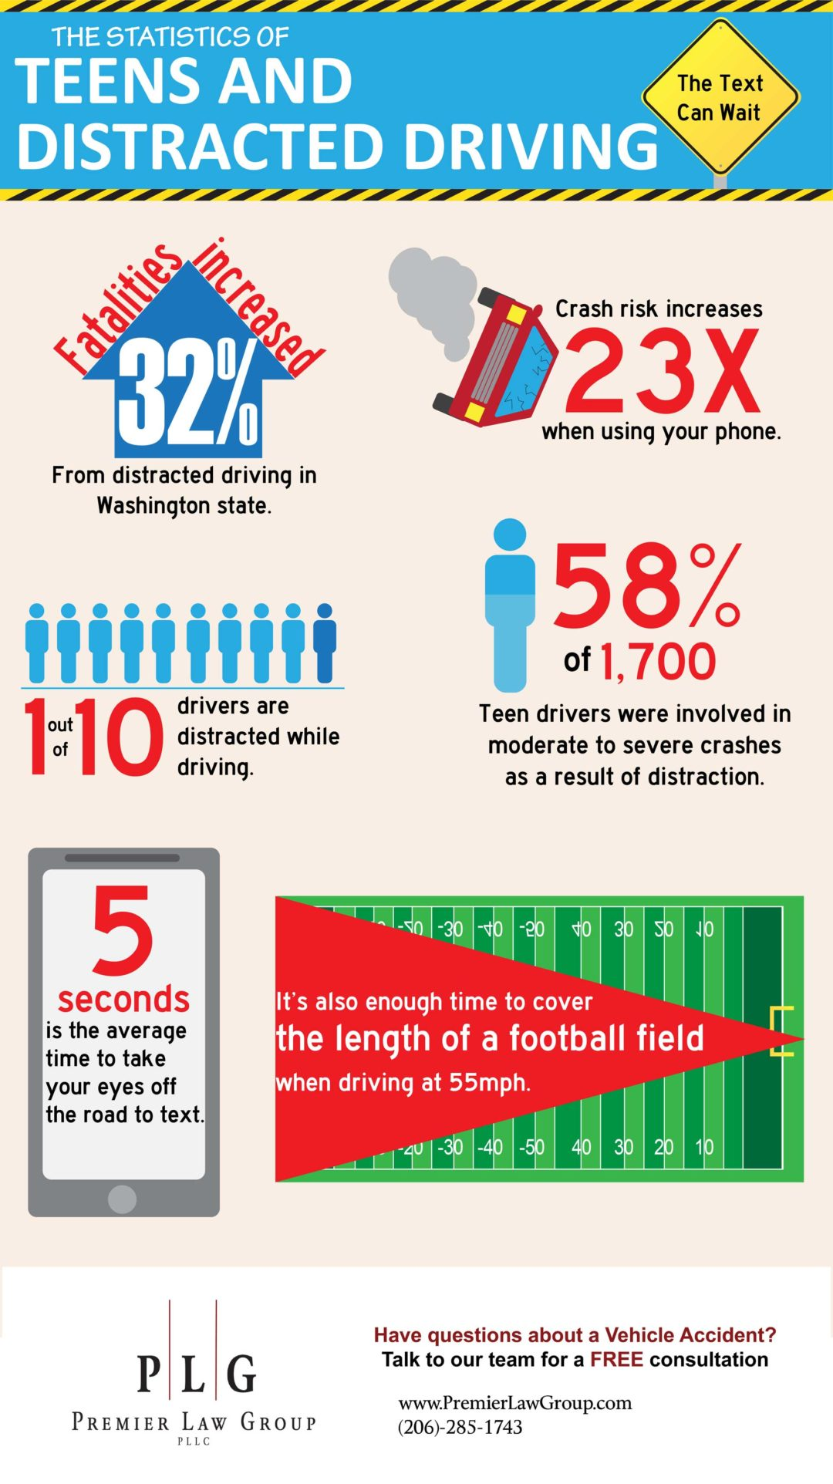
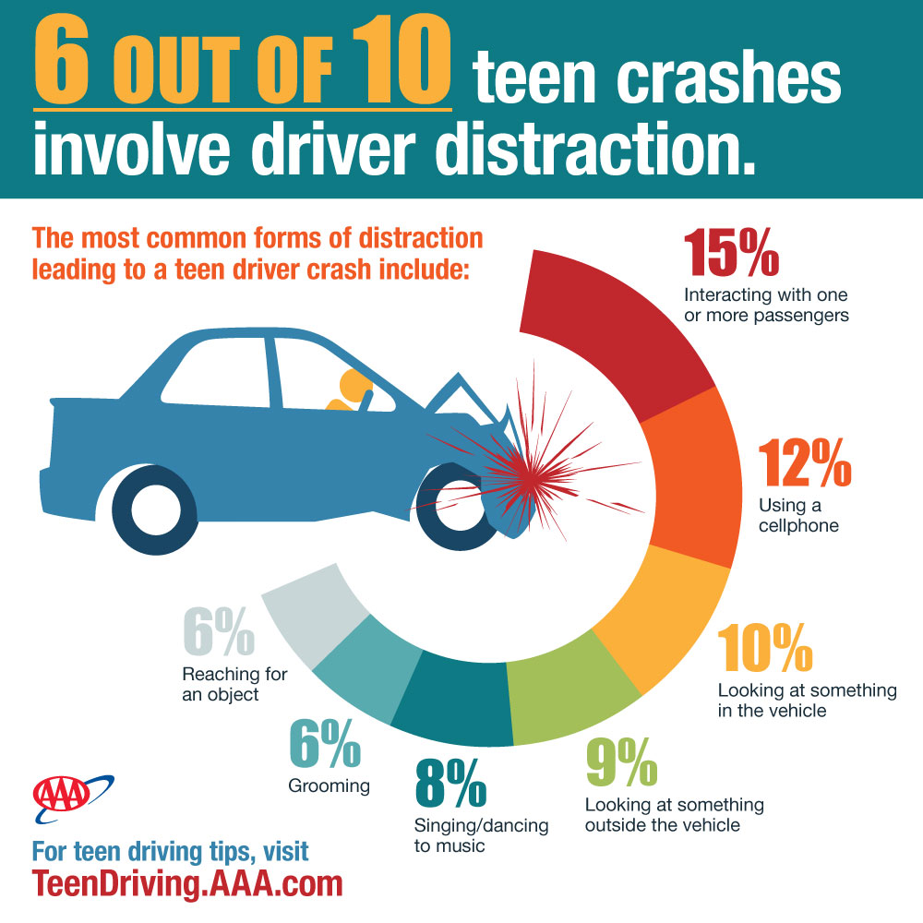
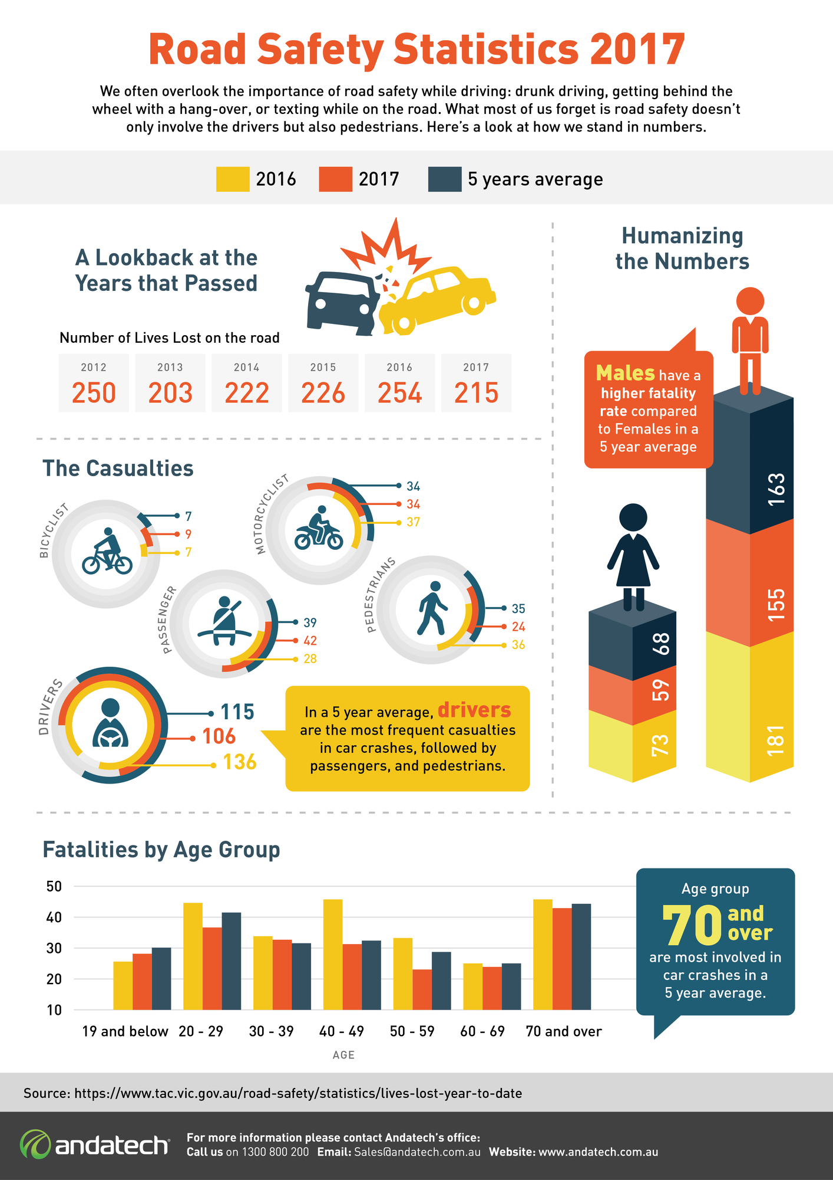
Looking at the infographics, what do you notice?

Slide 5
Infographics
There are many numbers in infographics. They display statistics and graphs in different, non traditional methods. They also illustrate concepts and organise information into Aesthetically pleasing formats.
Lets look at other infographics and analyse how they display data and wether you think they are effective in delivering their messages
https://visual.ly/community/infographic/transportation/roadside-deabte
https://rac.com.au/car-motoring/info/state_wa-fatalities
Be advised that the above links are about road deaths, and car related injuries.

Slide 6
Infographic videos
Social media has given rise to more informed citizens of the world, and freely available educational videos are uploaded regularly to You-Tube
These videos often use the same features that infographics do to get their information across.
Vibrant colours, graphs and numbers help to engage the audience and convey their meaning.
Watch the infographic video below to see how they display there data
https://www.youtube.com/watch?v=Vz_eZD_vtZM

